Slide 1
MID TERM PROJECT
Course Instructor: Dr. Ahmad Taher Azar
Email: Ahmad_t_azar@ieee.org
Teaching Assistant: Eng. Hosam Hassan
Email: hhassan@nu.edu.eg
Website: https://www.sites.google.com/site/drahmadtaherazar
11/20/2017
Temperature Control System

Slide 2
Team Members
Hedaya Ali (ID 171103)
Mohd Saiful Akmal Bin Razali (ID 171021)
Gabriel de Brito Silva (ID 171020)
Berit Adina Haendel (ID 171018)

Slide 3
Introduction
Temperature of single room model.
Requirements:
Obtain differential equation for the system.
Obtain transfer function for the system.
Obtain step response, ramp response & impulse response of the system.
Create the Hardware model for the circuit using Arduino.
Compare between model & Hardware model results.
Compare between Controller algorithms results:
Bang-Bang controller.
PID controller (at least three different tuning methods).

Slide 4
Program Architecture
1. Without Controller
Set point
LCD/
Serial
Software
Bang Bang
Linear improved
bang bang
T
+
-
Physical System
Blackbox
T
2. With Controller
Set point
LCD/
Serial
PID
Software
T
+
Blackbox
-
Physical System
T

Slide 5
Program Architecture (2)
3. With Controller
-
PID
Heater
+
T
LCD/
Serial
Set point
PID
Cooler
+
-

Slide 6
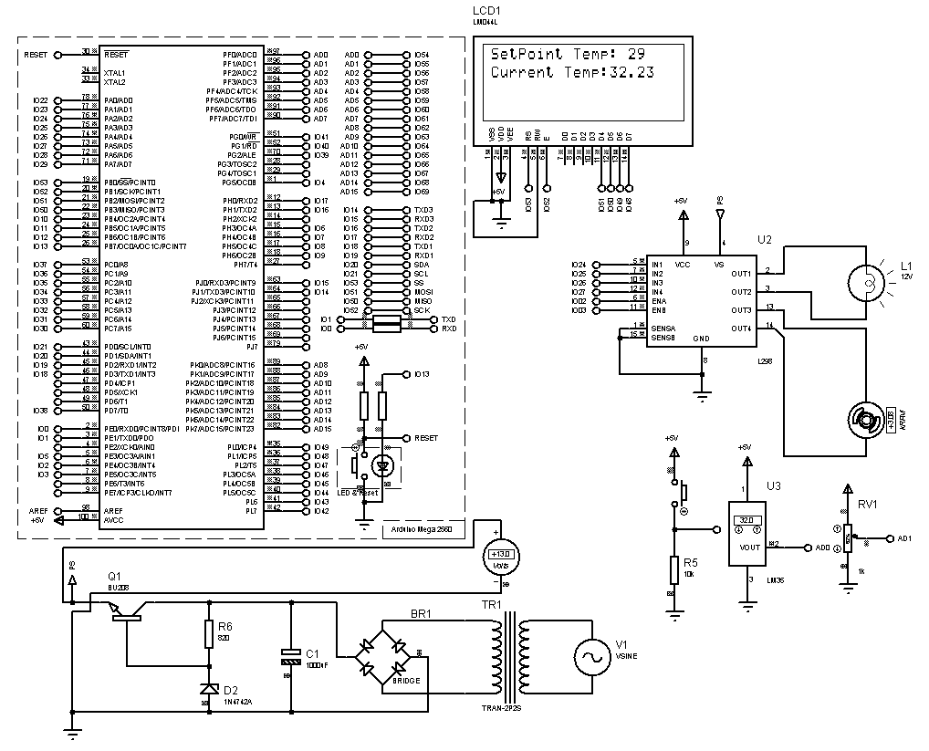
Circuit Diagram - Proteus
Simulation in Proteus shown that the system is working

Slide 7
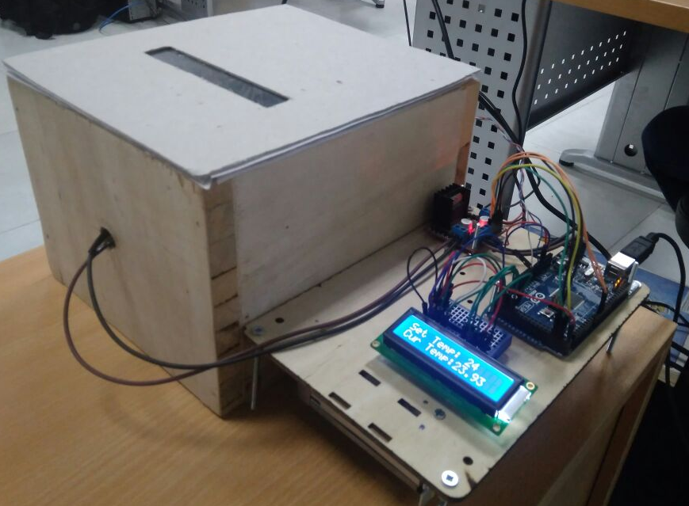
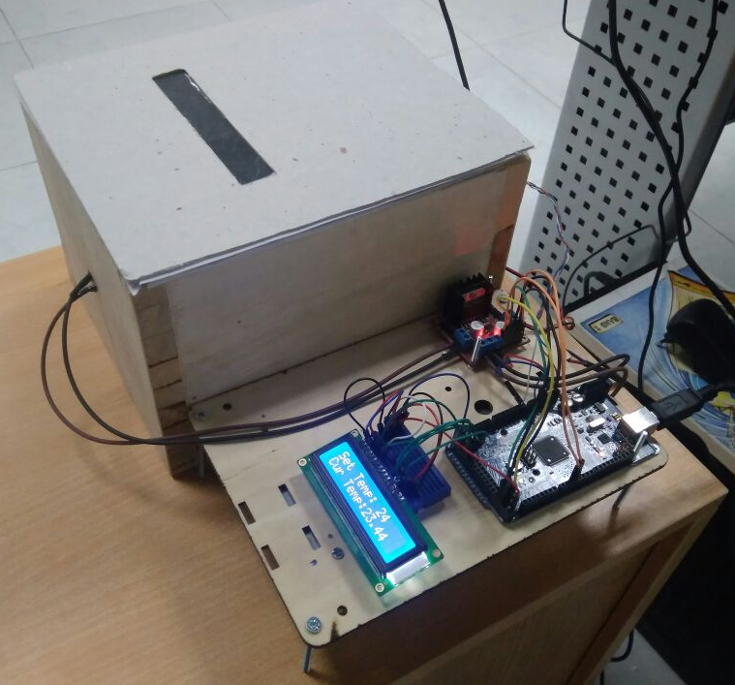
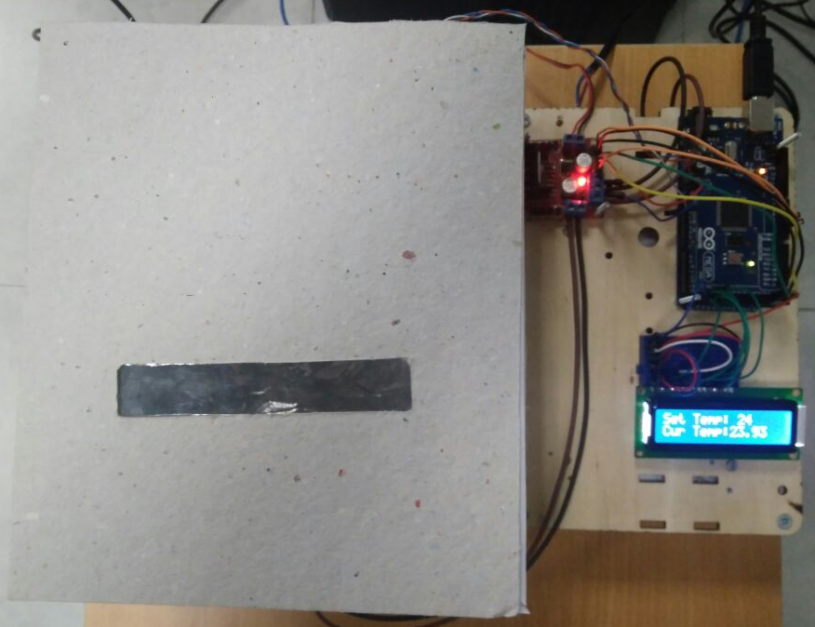
Hardware

Slide 8
Determine TF

Slide 9
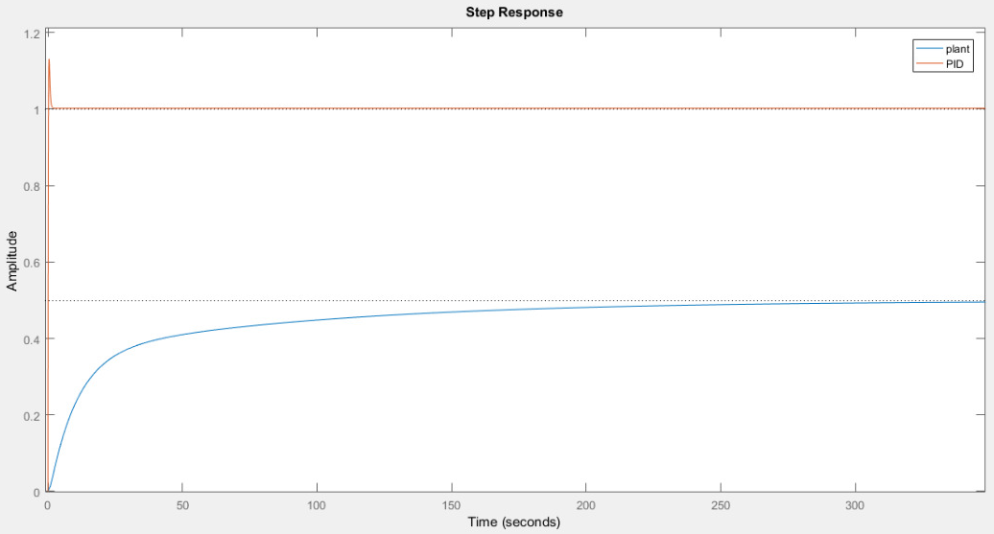

Plant vs PID
$\text{C}\text{=}\text{Kp}\text{+}\text{Ki}\text{∗}\frac{\text{1}}{\text{s}}\text{+}\text{Kd}\text{∗}\text{s}$
with Kp = 692, Ki = 528, Kd = 177

Slide 10
Improvement through Smoothing
Moving average over 5 measurements for the temperature improve step response w/o changing the plant:
Final value w/o smoothing: 28.545
Final value w/ smoothing: 28.680

Slide 11
Step Response w/o Controller

Slide 12


